Slide 1

Unlocking Toronto's Crime Trends A Journey through Data Science Capstone Project

Slide 2




Capstone II
Group #3 – Team members
Srilakshmi Gummadidala
Vinod Soloman Santhakumar
Tehsin Shaikh
Yen Nga Le

Slide 3
Introduction
Crime, as a pervasive social issue, profoundly impacts individuals and communities, necessitating a comprehensive approach towards prevention and intervention. This project embarks on an exploration of crime in Toronto, recognizing its significance in shaping effective crime prevention strategies and promoting community well-being.
With the alarming rise in crime incidents, the urgency to delve into crime trends and prevention strategies becomes apparent. By leveraging reliable data sources, the project seeks to provide valuable insights for investigation agencies, fostering a safer environment for all residents.
Through a meticulous analysis of crime factors and high-crime areas, coupled with an assessment of existing prevention measures, the project aims to contribute to the reduction of major crimes and the enhancement of public safety. Ultimately, our efforts aspire to foster a safer and more secure community for the diverse population of Toronto.

Slide 4
Data Science Process
Our analytical journey of a crime rate analysis project divided into eight key steps:
Define the Business Problem and Identify Stakeholders
Identify Data Sources/Collect Relevant Data
Clean/ Prepare data for Analysis.
Exploratory Data Analysis (EDA)
Feature Engineering/Data Preprocessing
Data Modeling
Interpretation
Conclusion and Next Steps

Slide 5
Problem Statement and Identify Stakeholders
Understanding the Business Problem
Business Problem: Our project aims to delve deep into the crime trends within the city of Toronto. By analyzing extensive crime data, we focus on identifying patterns, hotspots, and factors influencing crime rates.
Key Stakeholders
Law Enforcement Agencies: Utilize findings to strategize and implement effective policing.
Policymakers: Make informed decisions to enhance public safety regulations and resource allocation.
Community Organizations: Use insights for community awareness and preventive measures.
Residents of Toronto: Direct beneficiaries of improved safety and security measures in the city.

Slide 6
Data Collection and Methodology
Data Collection
The dataset is provided by the Toronto Police Service and can be accessed through the Toronto Public Safety Portal. The portal aims to promote transparency and public awareness regarding crime in the city.
Data Fields
The dataset includes various variables that provide information about each crime incident such as date and related offences, categories include Assault, Break and Enter, Auto Theft, Robbery and Theft Over, Premises type, location, neighborhood, latitude, and longitude, etc.
Data Cleaning
Removed missing values from the dataset.
Removed redundant columns like X and Y, which duplicated information already present in Longitude and Latitude columns.
Filtered the dataset to include records only from the years 2014 to 2023 due to limited availability of records from 2003 to 2013.

Slide 7
Data Collection and Methodology
Methodology
Data Preprocessing using Python Libraries:
Python libraries played a crucial role in refining our raw datasets for analysis. These preprocessing steps were pivotal in preparing a clean and standardized dataset, laying the foundation for our subsequent machine learning model.
Data Visualization with Tableau:
Using Tableau, we crafted interactive visualizations showcasing crime trends over time and space. Demographic insights and the exploration of environmental factors were seamlessly portrayed, providing a comprehensive understanding of the contextual elements influencing criminal activity.

Slide 8
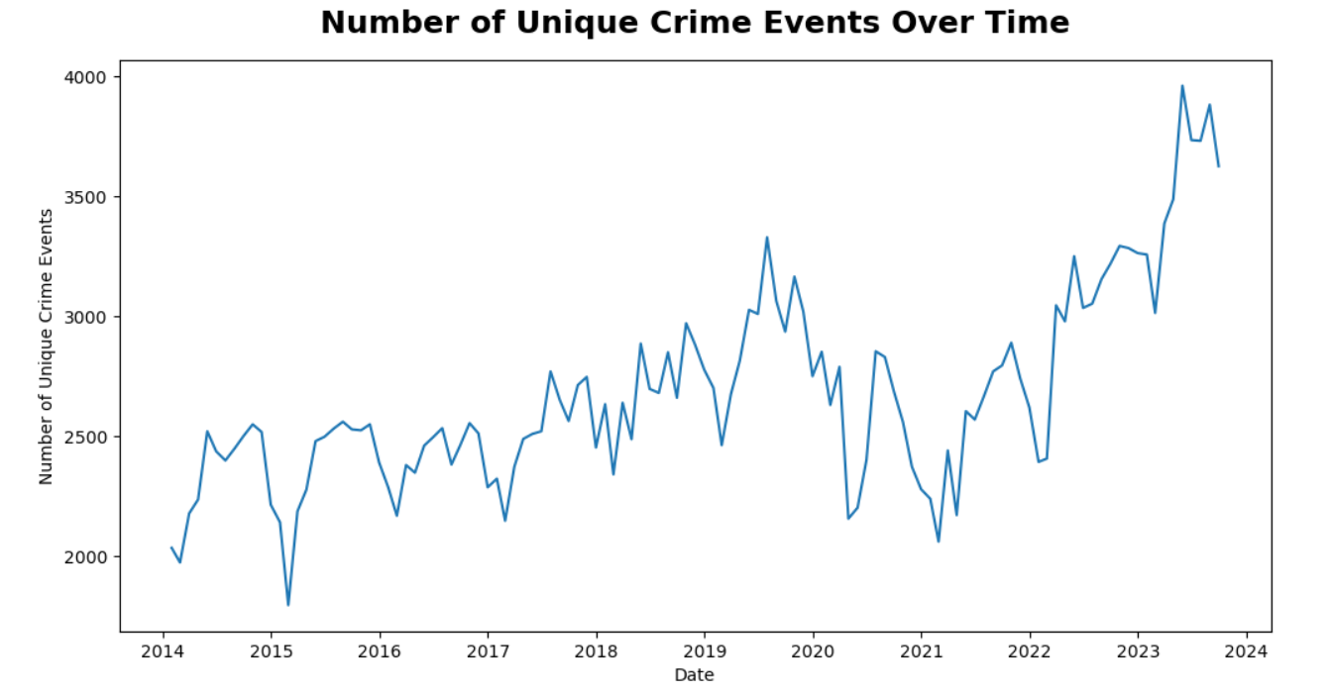
Exploratory Data Analysis (EDA)
Key Observation:
A general upward trend in the frequency of crime events over the years is evident.
The presence of fluctuations indicates that the trend is not entirely linear.
Suggests a potential worsening of the crime situation in Toronto over time.

Slide 9
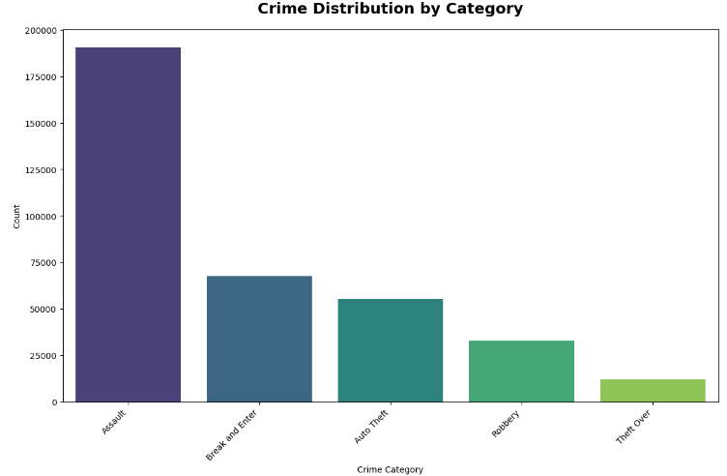
Exploratory Data Analysis (EDA)
Key Observation:
Assault has the highest count, significantly surpassing other categories.
The second most common crime is "Break and Enter," followed by "Auto Theft," and "Robbery," with "Theft Over" being the least frequent
Suggests a potential need for targeted prevention and intervention strategies to address and reduce the incidence of assault.

Slide 10
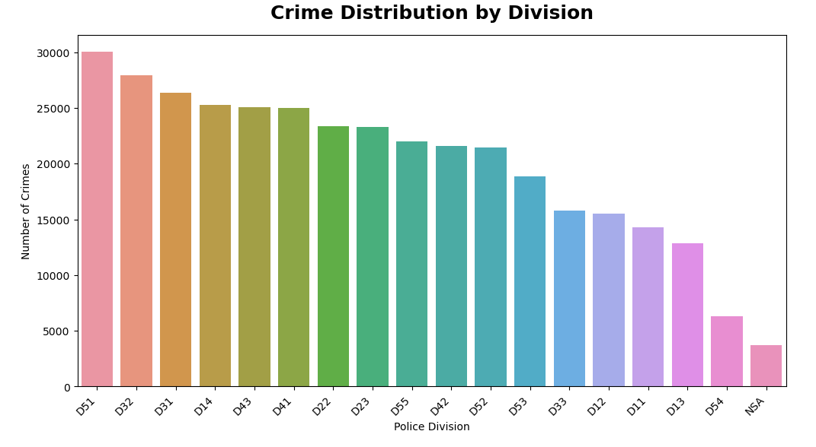
Exploratory Data Analysis (EDA)
Key Observation:
Divisions D51, D32, D31, and D14 stand out with the highest reported crime rates.
Conversely, divisions D54 and NSA demonstrate comparatively lower crime rates.
Imbalance in crime distribution highlights the need for targeted interventions and resource allocation.

Slide 11
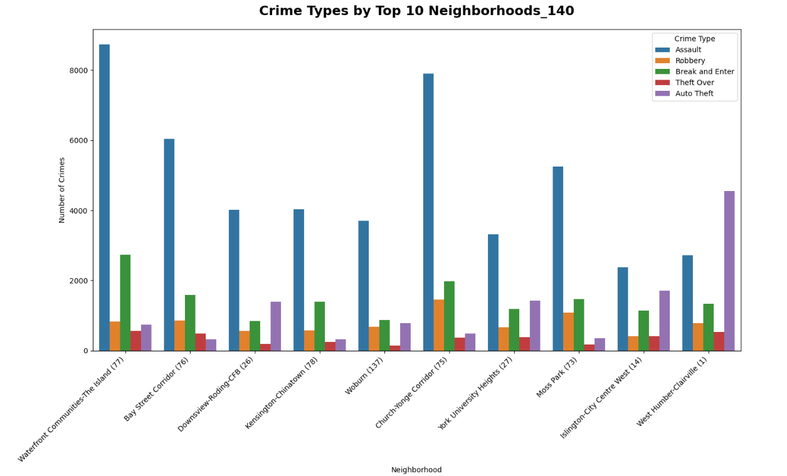
Exploratory Data Analysis (EDA)
Key Observation:
Assault remains the predominant crime category across the old Neighborhood 140 structure, indicating its significance in crime patterns.
West Humber – Clairsville (1) exhibits the highest crime rate specifically in the Auto Theft category.

Slide 12
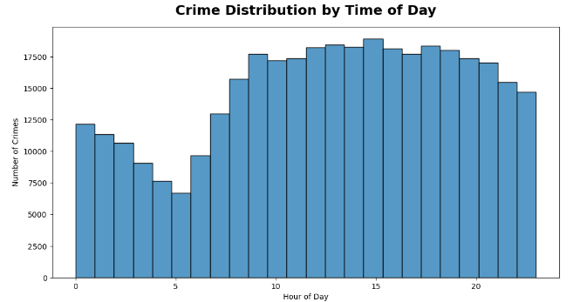
Exploratory Data Analysis (EDA)
Key Observation:
Peak Times: Peak times, such as 1:00 PM and 3:00 PM, exhibit higher frequencies of reported incidents.
Off-Peak Times: Off-peak times, such as 4:00 AM and 5:00 AM, experience lower levels of criminal activity.

Slide 13
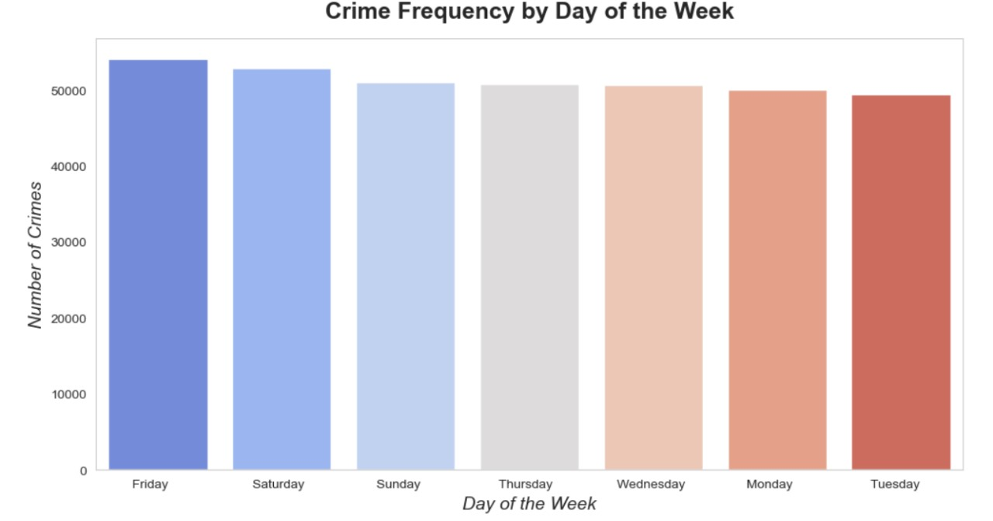
Exploratory Data Analysis (EDA)
Key Observation:
Weekend Peaks:
Fridays experience the highest number of reported crimes, followed closely by Saturdays and Sundays.
Weekday Trends:
Thursdays, Wednesdays, and Mondays also exhibit considerable crime rates, albeit slightly lower than Fridays.
Tuesdays consistently have the lowest count of reported crimes throughout the week.

Slide 14
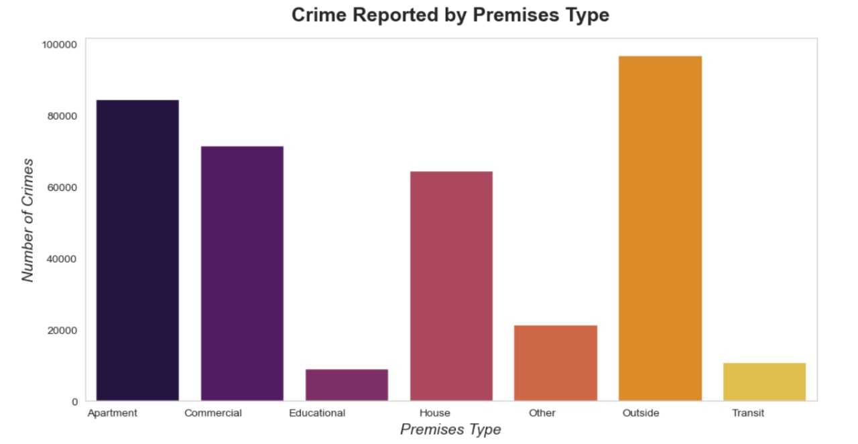
Exploratory Data Analysis (EDA)
Key Observation:
Majority of reported crimes occurred in outdoor areas, apartments, commercial establishments, and houses.
The "Other" category encompasses a notable number of incidents, likely representing diverse locations not explicitly specified.
Relatively fewer crime incidents were reported in transit and educational premises.

Slide 15
Feature Engineering/Data Preprocessing
Utilizing Encoding Techniques:
Mapping categorical variables to numerical values to enable processing by machine learning algorithms.
Employing various encoding techniques such as ordinal, frequency, count, and one-hot encoding to transform categorical columns effectively.
Converting Categorical Columns:
Mapping month names, days of the week, and other categorical variables to numerical values for machine learning compatibility.
Employing frequency encoding for 'DIVISION' and 'LOCATION_TYPE' columns and one-hot encoding for 'PREMISES_TYPE'.
Normalizing Data:
Normalizing numerical features (except the target variable = MCI Category) to ensure consistent scale (typically between 0 and 1).
Preventing features with larger magnitudes from dominating the modeling process, thus avoiding biased results.

Slide 16
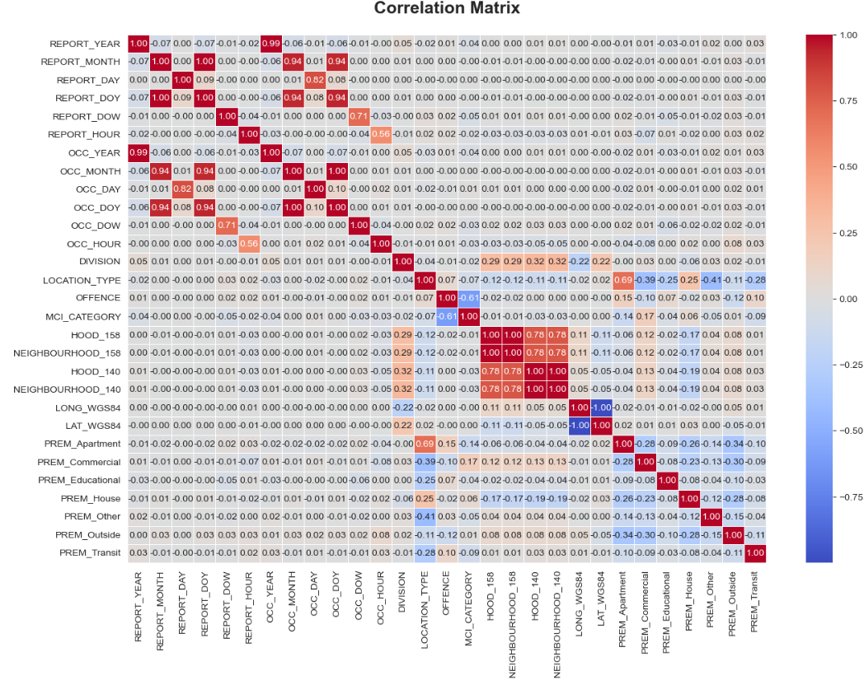
Feature Engineering/Data Preprocessing
Key Observation:
REPORT_YEAR and OCC_YEAR (0.99): Indicating that the year of the report closely aligns with the year of occurrence, as expected.
REPORT_MONTH and OCC_MONTH (0.94): Showing that the month of the report is usually the same as the month when the crime occurred.
OCC_DAY and REPORT_DAY (0.82): Suggesting a strong tendency for crimes to be reported on the same day they occur.

Slide 17
Brief overview of the Data Modeling phase
Our aim is to leverage machine learning to predict future crime rates by analyzing historical data patterns.
This process involves selecting suitable algorithms, dividing the data into training, and testing sets, training the models, and evaluating their performance using various metrics.
We've chosen a variety of models to analyze crime rate predictions, encompassing the Random Forest Classifier, Logistic Regression, Neural Networks, and Time Series Analysis – including SARIMAX and LSTM Models. Additionally, we utilized the Lazy Predict method to identify the optimal classifier model.
This diverse selection allows us to compare the performance of different algorithms and choose the most suitable one based on factors like accuracy, interpretability, and computational efficiency.
We’re currently refining our models to enhance their accuracy and robustness against unseen data, aiming to identify the most effective model for deployment.
Through iterative refinement and evaluation, we strive to uncover insights and patterns that can inform proactive measures for crime prevention and law enforcement efforts.

Slide 18
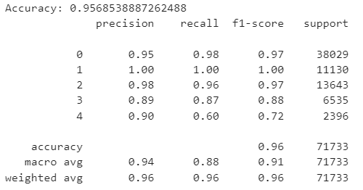
Random Forest Classifier Model
The Random Forest Classifier model, a popular ensemble learning method, was utilized for crime rate prediction.
Initially, the dataset was split into features (X) and the target variable (y), representing the Major Crime Indicators (MCI) categories. Subsequently, the data was divided into training and testing sets using an 80:20 ratio.
Model achieved an accuracy of approximately 95.69%.
Classification report indicates strong performance across various metrics.
High precision and recall scores for most crime categories, indicating accurate classification with minimal errors.
Lower precision and recall scores for category (Auto Theft) labeled as 4, likely due to its less frequent occurrence.
Imbalanced representation of this category in the dataset may have affected the model's performance.
Labels: 0 – Assault, 1 – Robbery, 2 – Break & Enter, 3 – Theft Over, 4 – Auto Theft

Slide 19
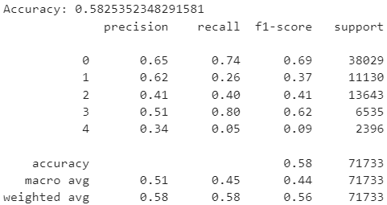
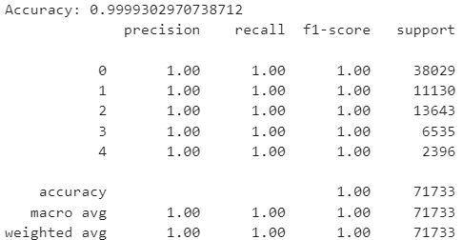
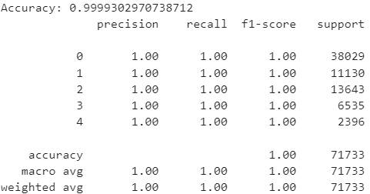



Feature Importances and other Modeling Methods
We have utilized various feature importance methods to identify the most critical features for our modeling process.
By employing these methods, we aim to mitigate bias and overfitting that may arise from relying solely on a baseline random forest model.
Gradient Boosting Machines (XGBoost)
Logistic Regression
Decision Trees

Slide 20
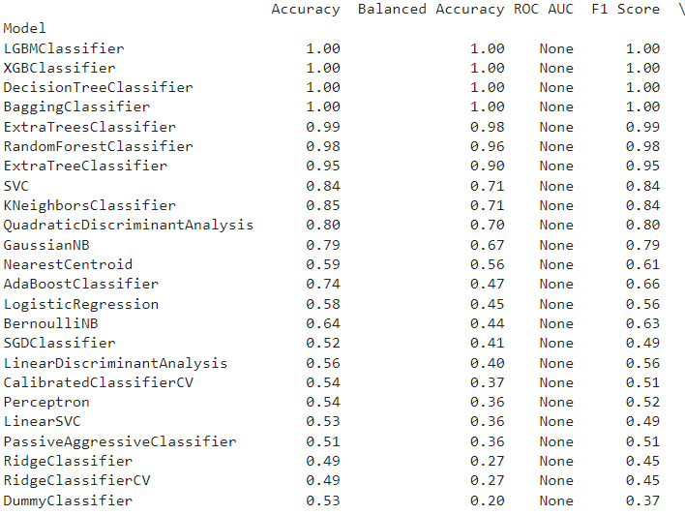
Lazy Predict Method
The Lazy Predict method provides a quick overview of various classifier models' performance without the need for extensive manual configuration.
The Lazy Predict method offers a comprehensive comparison of multiple classifier models, enabling quick identification of the most effective ones for further optimization.
Top-performing models achieved high accuracies, with some reaching 100%.
Less reliable models showed lower accuracy scores.

Slide 21
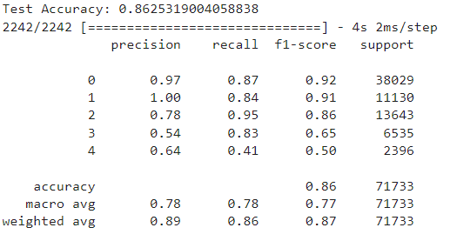
Neural Networks(Fully Connected)
As many of our classification models attained exceptionally high accuracy scores, there arises a concern regarding potential overfitting.
To address this, we advanced towards employing fully connected neural networks, leveraging their ability to handle complex data structures more effectively.
The neural network model was trained over 10 epochs, complied using “Adam” optimizer.
The model achieved a test accuracy of 86.25%, indicating its generalization performance on unseen data.
The precision, recall, and F1-score for each crime category varied, with higher scores for more prevalent categories and lower scores for less frequent ones.
Overall, the model demonstrated reasonable performance in classifying crime categories, with room for improvement in handling less represented categories.

Slide 22
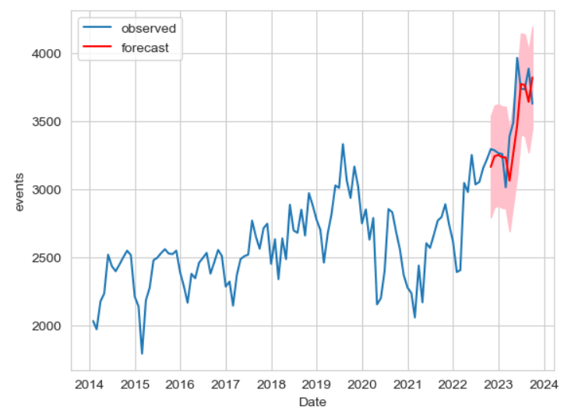
Time Series Analysis
Given the temporal nature of our data patterns, we've chosen to extend our analysis by integrating time series analysis techniques, including seasonal ARIMA (SARIMA) and long short-term memory (LSTM) models.
SARIMAX Model:
Based on the Augmented Dickey-Fuller test results(P > 0.05) indicating the presence of seasonality and trend components in the data, we opted for the SARIMAX (Seasonal Autoregressive Integrated Moving Average with Exogenous Variables) model for further analysis.
One Step Forecasting using SARIMAX model (2,1,2):
The one-step forecast generated from SARIMAX model forecasts events for the next twelve months.
Predicted mean values show an increasing trend over time.
Fluctuations are observed in certain months.
Confidence intervals provide the likely range for actual values.
Lower and upper limits give bounds for the forecasts.

Slide 23
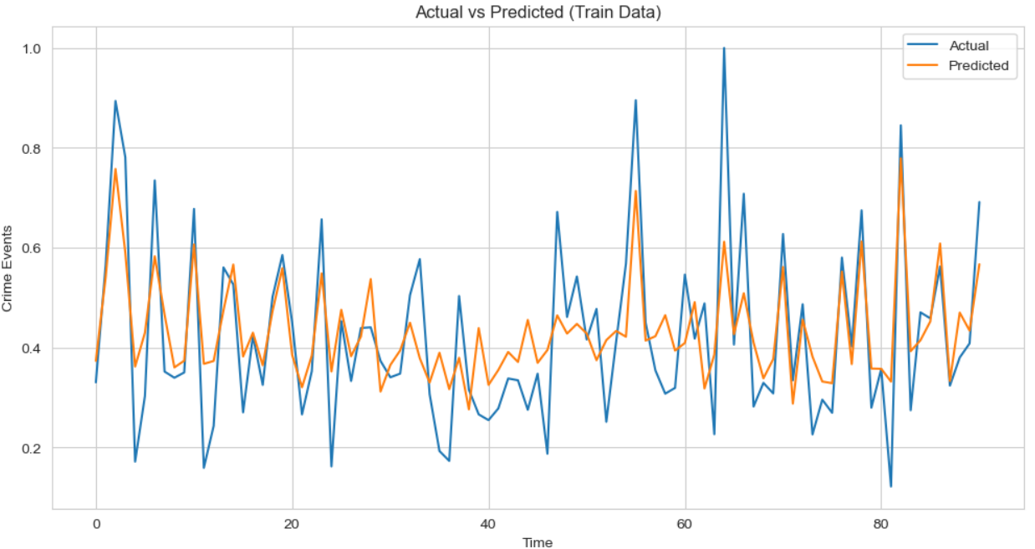
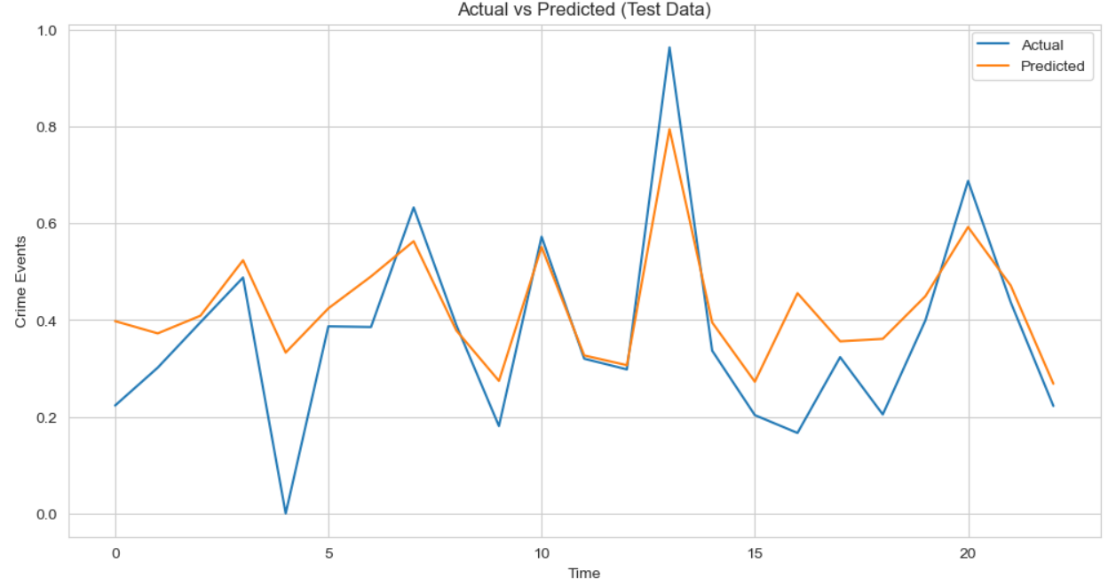
LSTM (Long Short-Term Memory) Model:
LSTMs are well-suited for capturing long-term dependencies and patterns in sequential data due to their ability to remember information over extended time intervals.
By training an LSTM model on historical crime rate data, we aim to leverage its capacity to learn from past observations and make accurate predictions for future time points.

Slide 24
Interpretation
Based on the extensive analysis and results obtained from our crime rate analysis project, several key interpretations emerge:
Feature Importance: Through feature analysis and correlation studies, we identified influential factors contributing to crime rates. Certain features showed strong correlations with crime occurrence, highlighting areas of focus for law enforcement and crime prevention strategies.
Predictive Modeling Performance: The machine learning models, including Random Forest Classifier, Logistic Regression and Neural Networks demonstrated varying levels of performance in predicting crime rates. While some models achieved high accuracy and precision, others exhibited limitations in capturing the complexity of the data.
Temporal Patterns: The time series analysis revealed significant temporal patterns and trends in the crime rate data. These patterns include seasonality, trends, and potentially cyclic behavior, providing valuable insights into the underlying dynamics of criminal activities over time.
Model Interpretability: The interpretability of models such as Neural Networks and Time Series analysis models allowed us to understand the underlying factors driving crime rates. This insight can aid policymakers and law enforcement agencies in developing targeted interventions and allocating resources effectively.

Slide 25
Conclusion
Feature importance analysis highlighted key factors driving crime occurrence. Actionable insights were generated for targeted crime prevention strategies.
Comprehensive analysis yielded valuable insights into crime rate patterns and influential factors. Models like Neural Networks, SARIMAX and LSTM showed promising predictive performance.
Next Steps
Next, we'll choose the most optimal models, considering both performance and interpretability. We'll seamlessly integrate these models into our current decision-making frameworks and validate their efficacy using real-time data, engaging stakeholders throughout the process.
Additionally, we'll provide comprehensive training for proficient model utilization. Ethical considerations will be carefully addressed, and safeguards will be implemented to ensure fair deployment. We'll establish continuous evaluation and monitoring mechanisms to uphold effectiveness over time.

Slide 26

Be Safe and Thank You!

